Slide 1

Today:
Central Tendency & Dispersion
From frequency tables to distributions
Types of Distributions: Normal, Skewed
Level of Measurement:
Nominal, Ordinal, Interval
Central Tendency: Mode, Median, Mean
Dispersion: Variance, Standard Deviation

Slide 2
Descriptive statistics are concerned with describing the characteristics of frequency distributions
Where is the center?
What is the range?
What is the shape [of the distribution]?

Slide 3
Frequency Distributions
Simple depiction of all the data
Graphic — easy to understand
Problems
  Not always precisely measured
  Not summarized in one number or datum

Slide 4
Frequency Table
Test Scores
Observation Frequency
65 1
70 2
75 3
80 4
85 3
90 2
95 1

Slide 5
Frequency Distributions
4
3
2
1
Frequency
65 70 75 80 85 90 95
Test Score

Slide 6
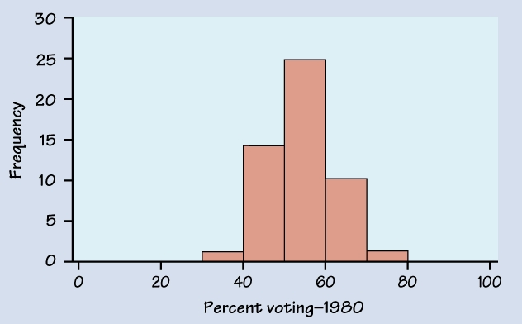
Voter Turnout in 50 States - 1980

Slide 7
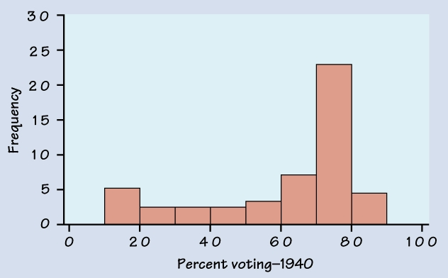
Voter Turnout in 50 States - 1940

Slide 8
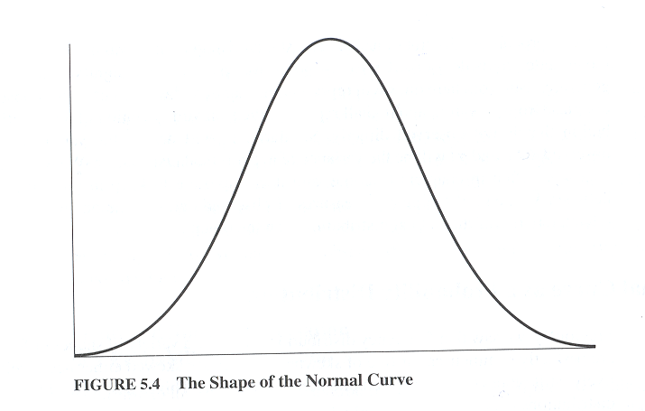
Normally Distributed Curve

Slide 9
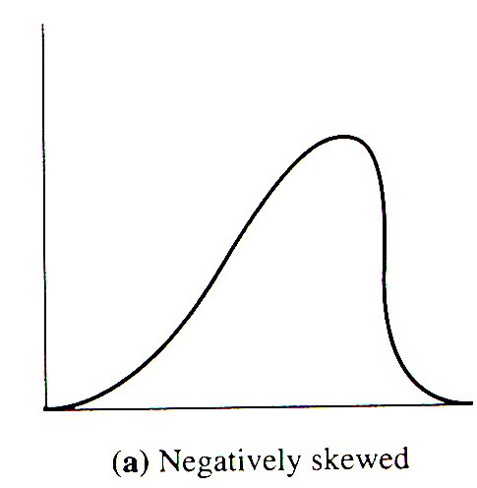
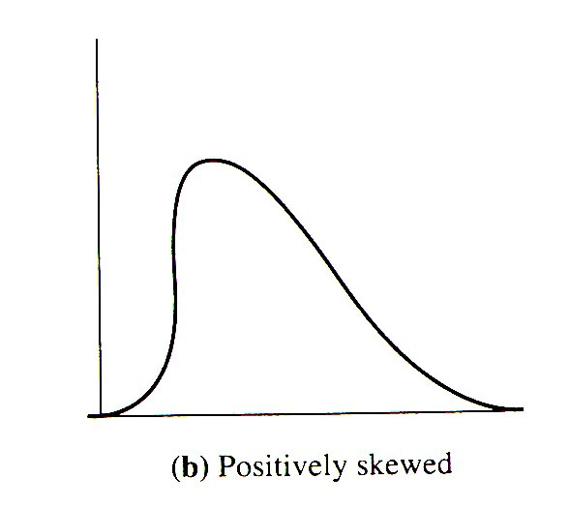
Skewed Distributions

Slide 10
Characteristics of the Normal Distribution
It is symmetrical -- Half the cases are to one side of the center; the other half is on the other side.
The distribution is single peaked, not bimodal or multi-modal
Most of the cases will fall in the center portion of the curve and as values of the variable become more extreme they become less frequent, with “outliers” at each of the “tails” of the distribution few in number.
It is only one of many frequency distributions but the one we will focus on for most of this course.
The Mean, Median, and Mode are the same.
Percentage of cases in any range of the curve can be calculated.

Slide 11
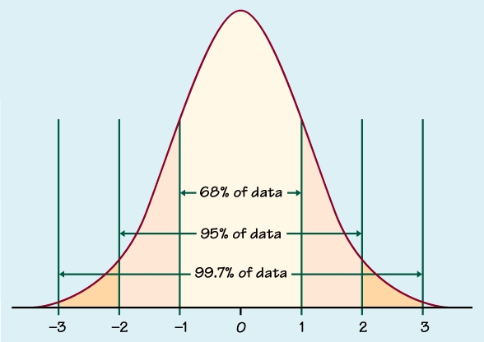

Slide 12
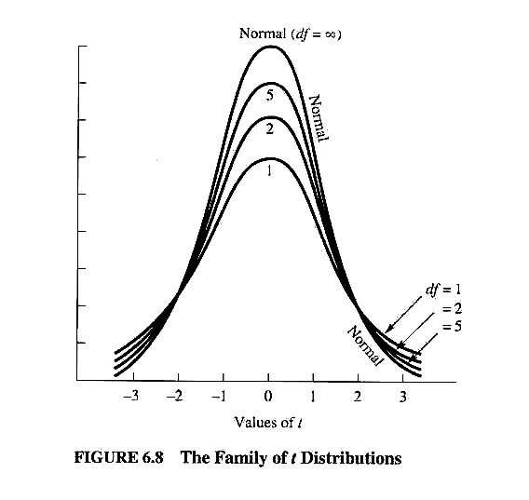
Family of Normal Curves

Slide 13
Summarizing Distributions
Two key characteristics of a frequency distribution are especially important when summarizing data or when making a prediction from one set of results to another:
Central Tendency
  What is in the “Middle”?
  What is most common?
  What would we use to predict?
Dispersion
  How Spread out is the distribution?
  What Shape is it?

Slide 14
Three measures of central tendency are commonly used in statistical analysis - the mode, the median, and the mean
Each measure is designed to represent a typical score
The choice of which measure to use depends on:
the shape of the distribution (whether normal or skewed), and
the variable’s “level of measurement” (data are nominal, ordinal or interval).

Slide 15
Appropriate Measures of
Central Tendency
Nominal variables Mode
Ordinal variables Median
Interval level variables Mean
- If the distribution is normal (median is better with skewed distribution)

Slide 16
Mode
Most Common Outcome
Male Female

Slide 17
Median
Middle-most Value
50% of observations are above the Median, 50% are below it
The difference in magnitude between the observations does not matter
Therefore, it is not sensitive to outliers
Formula Median = n + 1 / 2

Slide 18
To compute the median
•first you rank order the values of X from low to high: ➔ 85, 94, 94, 96, 96, 96, 96, 97, 97, 98
• then count number of observations = 10.
• add 1 = 11.
• divide by 2 to get the middle score ➔ the 5 ½ score
here 96 is the middle score score

Slide 19
Median
Find the Median
4 5 6 6 7 8 9 10 12
Find the Median
5 6 6 7 8 9 10 12
Find the Median
5 6 6 7 8 9 10 100,000

Slide 20
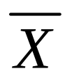
Mean - Average
Most common measure of central tendency
Best for making predictions
Applicable under two conditions:
scores are measured at the interval level, and
distribution is more or less normal [symmetrical].
Symbolized as:
  for the mean of a sample
  μ for the mean of a population

Slide 21
Finding the Mean
X = (Σ X) / N
If X = {3, 5, 10, 4, 3}
  X = (3 + 5 + 10 + 4 + 3) / 5
  = 25 / 5
  = 5

Slide 22
Find the Mean
Q: 4, 5, 8, 7
A: 6
Median: 6
Q: 4, 5, 8, 1000
A: 254.25
Median: 6.5

Slide 23
  IF THE DISTRIBUTION IS NORMAL
  Mean is the best measure of central tendency
    Most scores “bunched up” in middle
    Extreme scores less frequent ➔ don’t move mean around.

Slide 24
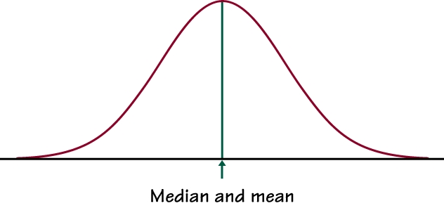

Slide 25
Measures of Variability
Central Tendency doesn’t tell us everything
Dispersion/Deviation/Spread tells us a lot about how a variable is distributed.
We are most interested in Standard Deviations (σ) and Variance (σ²)

Slide 26
Why can’t the mean tell us everything?
Mean describes Central Tendency, what the average outcome is.
We also want to know something about how accurate the mean is when making predictions.
The question becomes how good a representation of the distribution is the mean? How good is the mean as a description of central tendency -- or how good is the mean as a predictor?
Answer -- it depends on the shape of the distribution. Is the distribution normal or skewed?

Slide 27
Family of Normal Distribution Curves

Slide 28
Dispersion
Once you determine that the variable of interest is normally distributed, ideally by producing a
histogram of the scores, the next question to be
asked about the NDC is its dispersion: how spread out are the scores around the mean.
Dispersion is a key concept in statistical thinking.
The basic question being asked is how much do the scores deviate around the Mean? The more “bunched up” around the mean the better your ability to make accurate predictions.

Slide 29
Means
Consider these means for weekly candy bar consumption.
X = {7, 8, 6, 7, 7, 6, 8, 7}
X = (7+8+6+7+7+6+8+7)/8
X = 7
X = {12, 2, 0, 14, 10, 9, 5, 4}
X = (12+2+0+14+10+9+5+4)/8
X = 7
What is the difference?

Slide 30
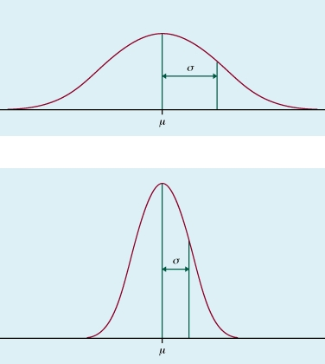

Slide 31
How well does the mean represent the scores in a distribution? The logic here is to determine how much spread is in the scores. How much do the scores "deviate" from the mean? Think of the mean as the true score or as your best guess. If every X were very close to the Mean, the mean would be a very good predictor.
If the distribution is very sharply peaked then the mean is a good measure of central tendency and if you were to use the mean to make predictions you would be right or close much of the time.

Slide 32
What if scores are widely distributed?
The mean is still your best measure and your best predictor, but your predictive power would be less.
How do we describe this?
Measures of variability
  Mean Deviation
  Variance
  Standard Deviation

Slide 33
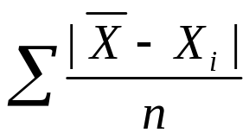
Mean Deviation
The key concept for describing normal distributions
and making predictions from them is called
deviation from the mean.
We could just calculate the average distance between each observation and the mean.
We must take the absolute value of the distance, otherwise they would just cancel out to zero!
Formula:

Slide 34
Mean Deviation: An Example
Data: X = {6, 10, 5, 4, 9, 8}
X = 42 / 6 = 7
X – Xi | Abs. Dev.
7 – 6 | 1
7 – 10 | 3
7 – 5 | 2
7 – 4 | 3
7 – 9 | 2
7 – 8 | 1
Compute X (Average)
Compute X – X and take the Absolute Value to get Absolute Deviations
Sum the Absolute Deviations
Divide the sum of the absolute deviations by N
Total: 12
12 / 6 = 2

Slide 35
What Does it Mean?
On Average, each observation is two units away from the mean.
Is it Really that Easy?
No!
Absolute values are difficult to manipulate algebraically
Absolute values cause enormous problems for calculus (Discontinuity)
We need something else…

Slide 36
Variance and Standard Deviation
Instead of taking the absolute value, we square the deviations from the mean. This yields a positive value.
This will result in measures we call the Variance and the Standard Deviation
Sample- Population-
s: Standard Deviation σ: Standard Deviation
s²: Variance σ²: Variance

Slide 37
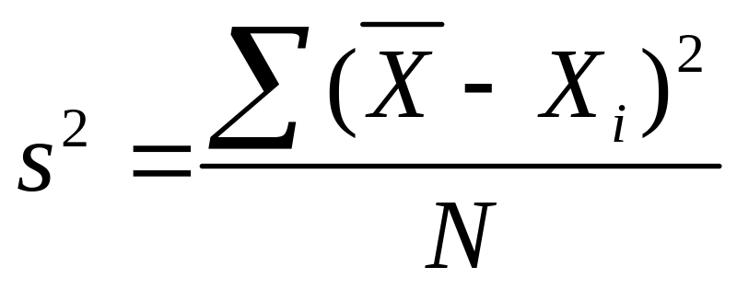
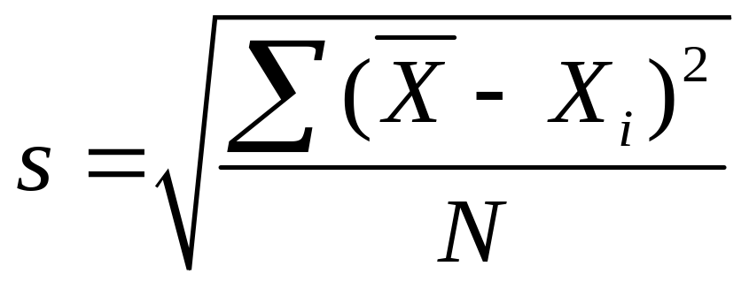
Calculating the Variance and/or Standard Deviation
Formulae:
Variance:
Examples Follow . . .
Standard Deviation:

Slide 38


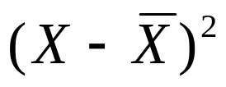
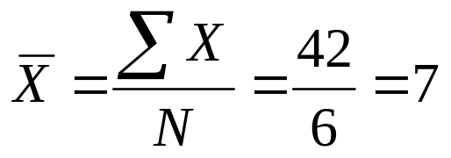
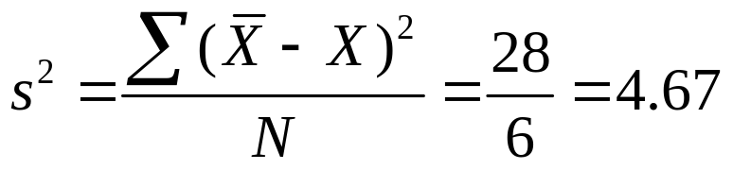
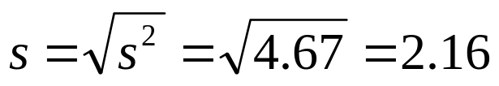
Example:
Data: X = {6, 10, 5, 4, 9, 8}; N = 6
Mean:
6
10
5
4
9
8
 | -1 | 1
 | 3 | 9
 | -2 | 4
 | -3 | 9
 | 2 | 4
 | 1 | 1
Variance:
Standard Deviation:
Total: 42
Total: 28

